Slide 1
Capstone Project – Classification Project -Airline Passenger Referral Prediction
Team Members
Sanchit Misra
Mohit Jain ,
Tushar Hande,

Slide 2
Problem Statement:- Data includes airline reviews from 2006 to 2019 for popular airlines around the world with multiple choice and free text questions. Data is scraped in Spring 2019. The main objective
is to predict whether passengers will refer the airline to their friends.
Attribute Information:
Airline: Name Of The Airline.
Overall: Overall Point Is Given To The Trip Between 1 To 10.
Author: Author Of The Trip
Review date: Date Of The Review
Customer Review: Review Of The Customers In Free Text Format
Aircraft: Type Of The Aircraft
Traveler type: Type Of Traveler (E.G. Business, Leisure)
Cabin: Cabin At The Flight
Route: Route of the flight.
Date Flown: Flight Date
Seat comfort: Rated Between 1-5
Cabin Service: Rated Between 1-5
Food : Rated Between 1-5
Entertainment: Rated Between 1-5
Ground service: Rated Between 1-5
Value for money: Rated Between 1-5
Recommended: Binary, Target Variable.

Slide 3
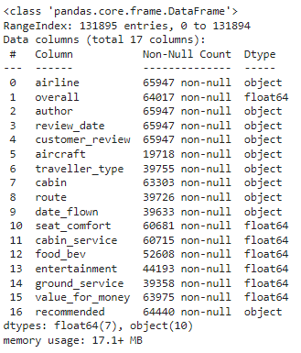
Data Inspection:-
Interpretation:-
By examining the info() method, we can see that there are 131895 rows in total and that the maximum number of non-NaN values is only 65947, indicating that every odd row is a NaN.
We next considered removing all odd rows from the dataset, however we realized later that the dataset's end still contained NaN rows.
Information of whole data set

Slide 4
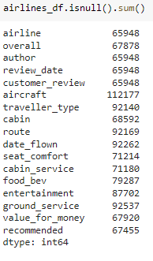
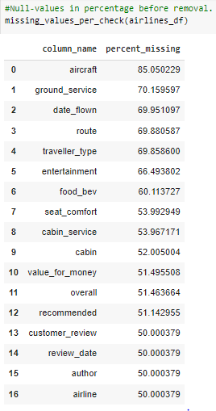
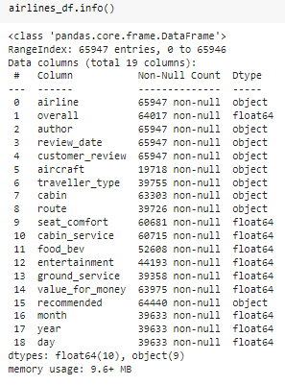
Checked and Handled Null and Duplicate Values.
Observation:-
After Duplicate and Null value removal we have now 65947 valid rows in our dataset that sequenced from 0 to 65946.
We have total 19 columns where 10 columns have float values and 9 have categorical values.

Slide 5
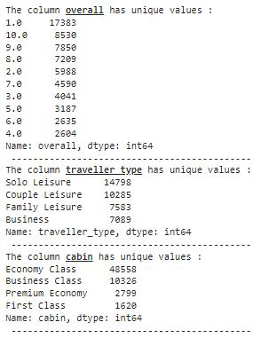
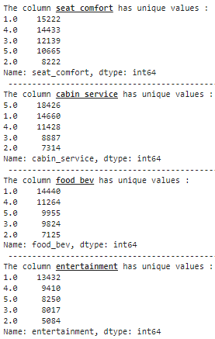
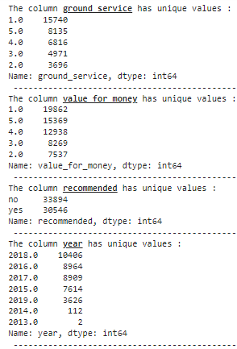
Checking unique values of Data Set.
Observation:-
The number of unique values present in dataset and the target variable has balanced data.
The day variable has only single value in it, therefore this column may be dropped

Slide 6
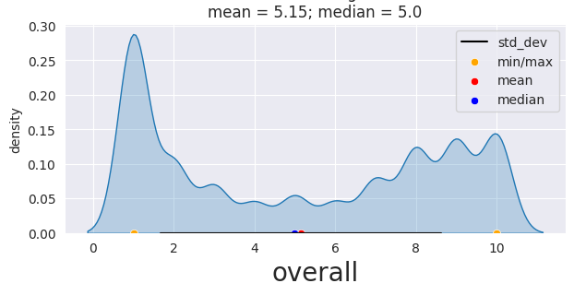
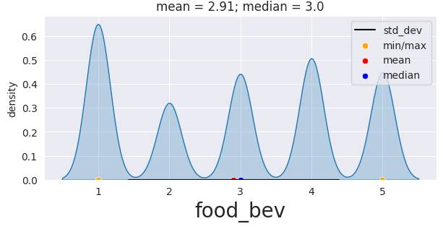
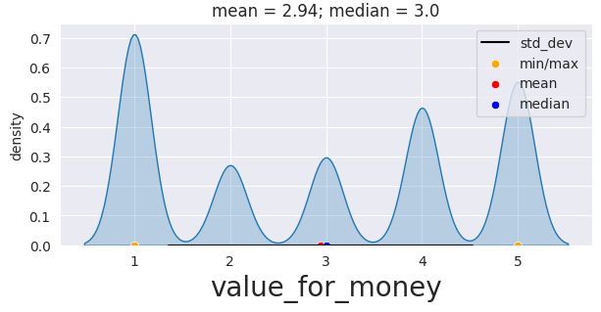
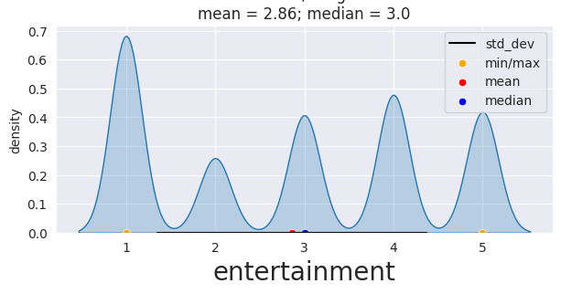
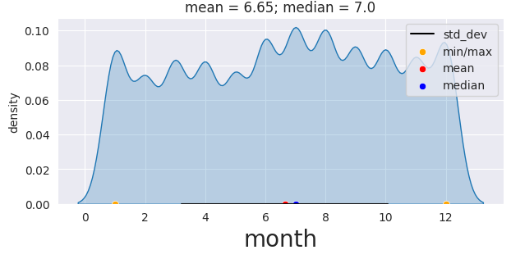
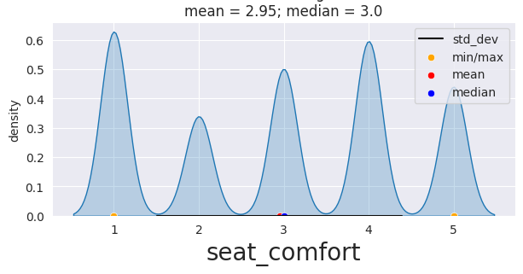
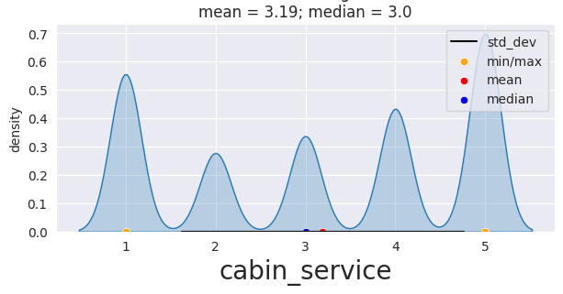
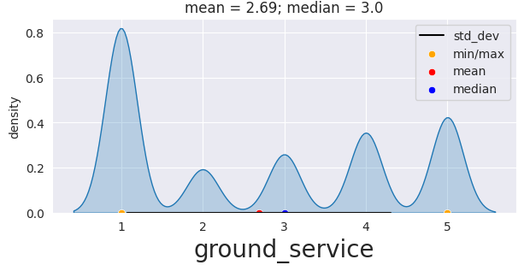
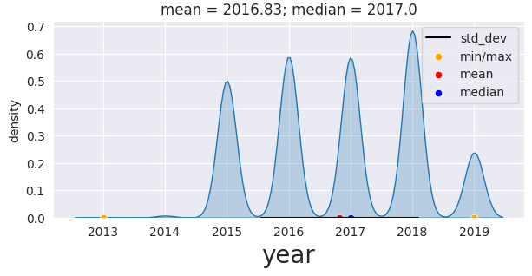
Exploratory Data Analysis(EDA):- Univariate distribution

Slide 7
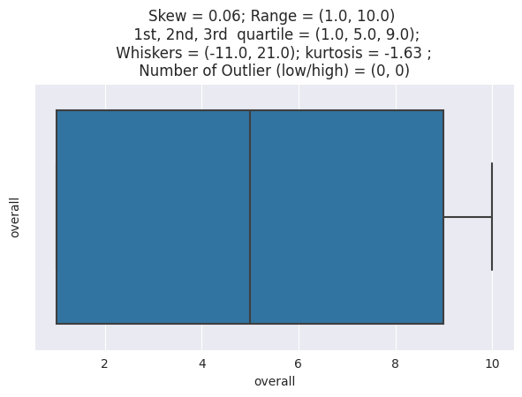
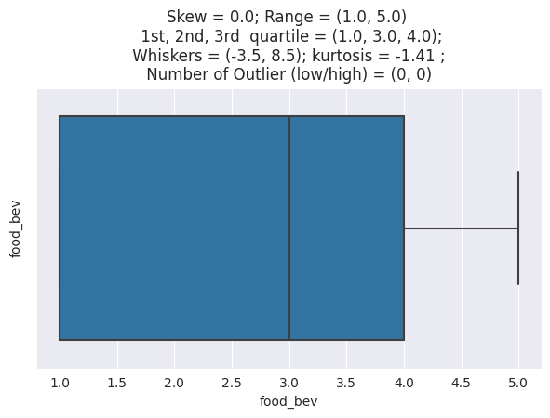
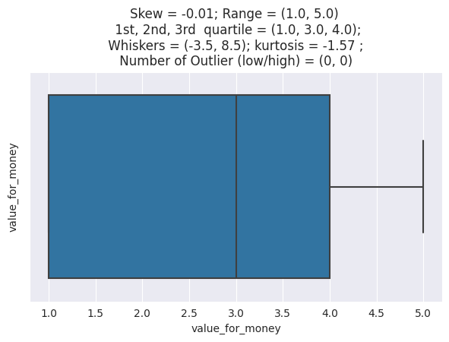


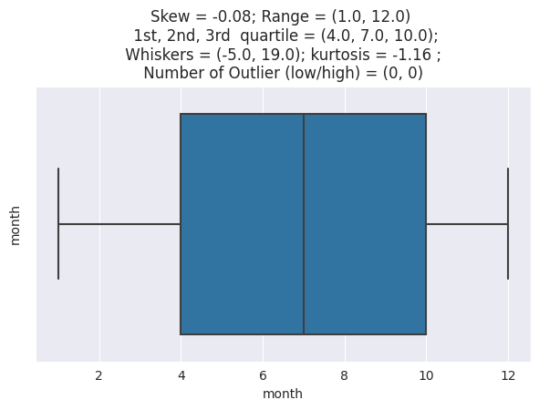
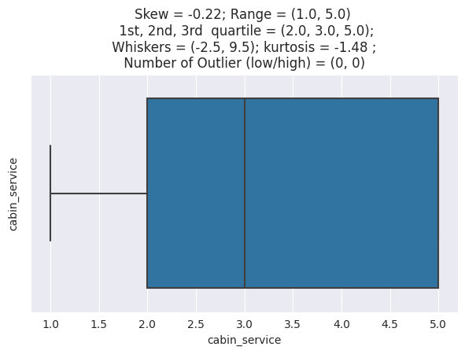

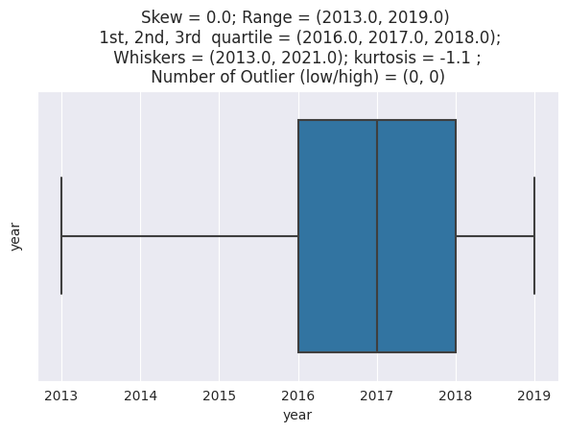
Outliers detection

Slide 8
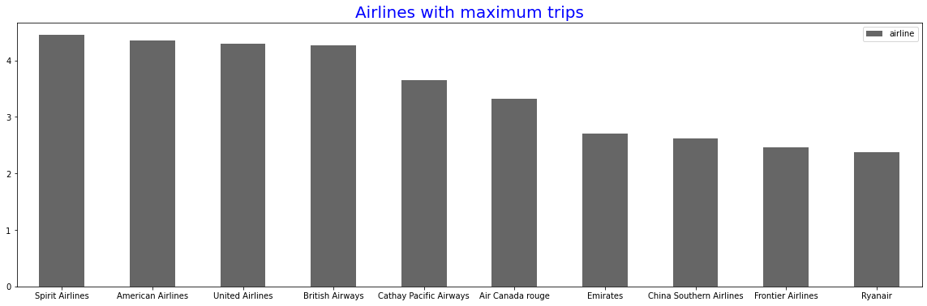
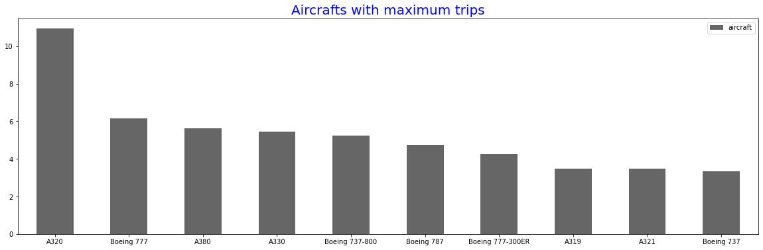
Analysed Maximum trip by Airline and top Aircrafts with maximum trips
Observation:-
According to the above analysis, Spirit Airlines holds the top spot for most journeys taken followed by American and United airlines.
Airbus A320 Aircraft holds the top spot for most journeys taken followed by Boeing 777 and Airbus A380 aircraft.

Slide 9
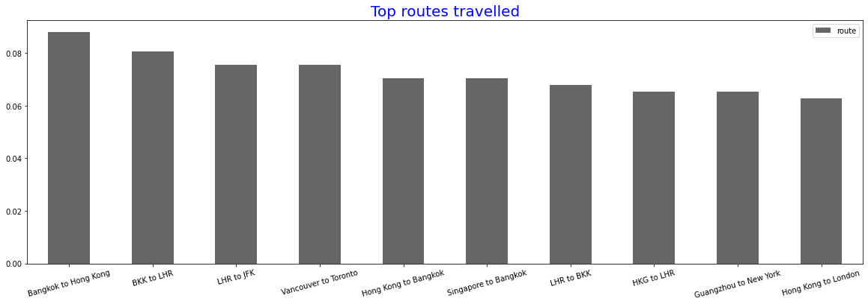
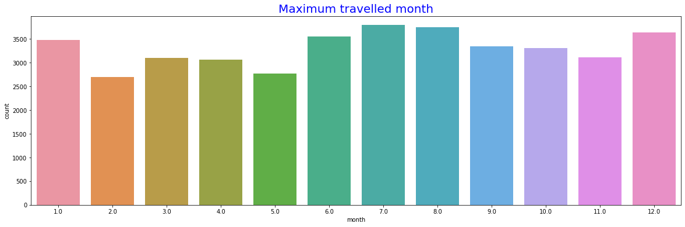
Top routes travelled across the world and Maximum Travelled Month
Observation:-
According to the above analysis, Bangkok to Hong Kong journey tops the position followed by Bangkok to London and London to New York.
The month of July is said to be the one with the highest travel. The second-most popular month for travel is December.

Slide 10
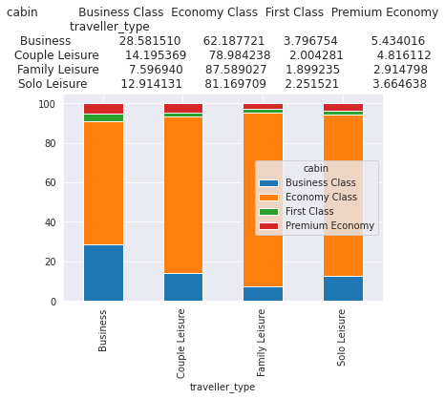
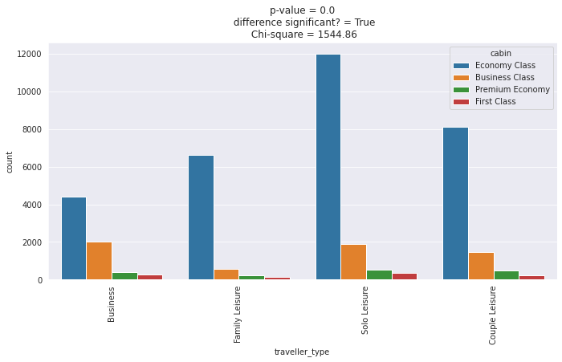
Bivariate Analysis
Observation:-
All types of traveler strongly prefer the economy class.
Some of the Business class and Couple Leisure people choose business class for travelling.
First class is least preferred among all traveler type categories.

Slide 11
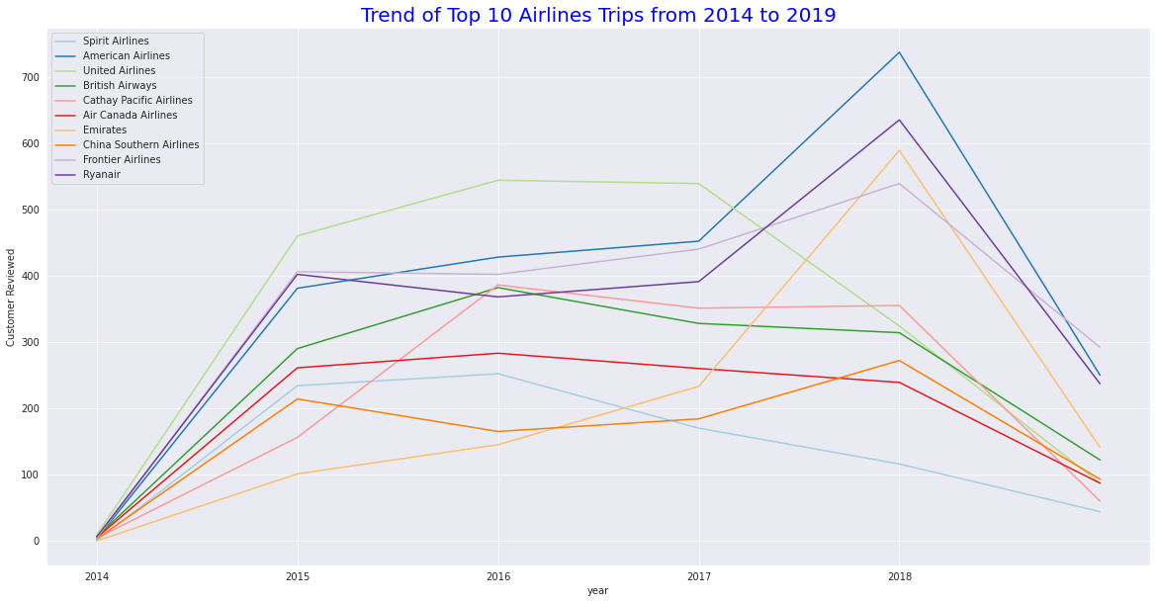
Trend of Top 10 Airlines Trips from 2014 to 2019
Observation:-
In its initial days American airlines was at low, but in 2018 it reaches to its all time peak and become top preferred airlines for their operations.
United airlines of USA retained their top position from 2014 to 2017, then its number of reviews degraded further.
Emirates airlines was least preferer in its initial days, but it increased its customer base in 2018 and retained their place in top 3 airlines.
We have also analyzed above that spirit airlines is least preferred by travelers, However we can also see that in the above trend graph.

Slide 12
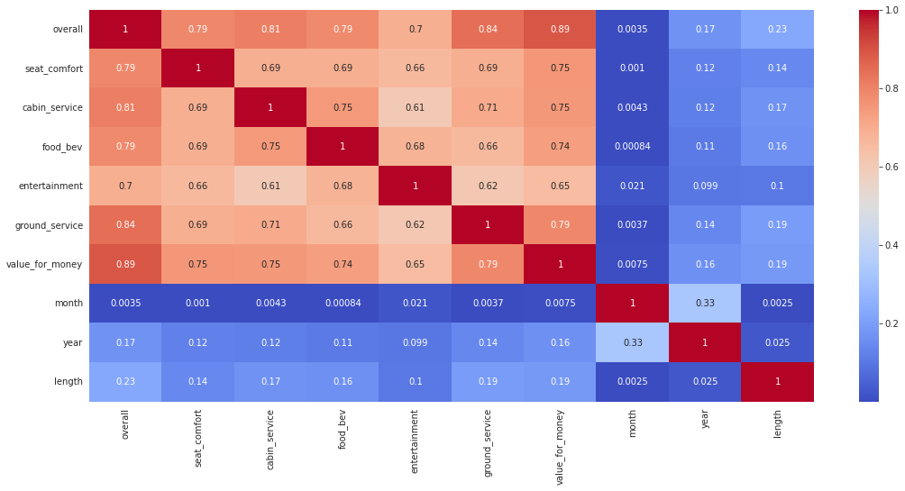
Identifying Multicollinearity:-
From the Heatmap we can see that:
All the Rating features are very strongly correlated to each other and to reduce it we can remove all rating features except overall column and proceed for further analysis .

Slide 13



Data Pre-processing
1.As to Work on sentiment analysis of the Customer review as it will be referred to someone or not. we have selected only three feature i.e. Recommended, Overall and Customer review.
2. After removal of all the Null values still around 1487 Null values present in the target feature i.e. Recommended column.
3. We handled Null Values of Recommended feature with the help of feature engineering on Overall Ratting Column.

Slide 14


Preparing dataset(Text Cleaning) of Customer review feature
Text cleaning is the process of preparing raw text for NLP (Natural Language Processing) so that machines can understand human language. Following approach is used here to clean the text of customer reviews:
Use pos_tag with nltk:- POS Tagging in NLTK is a process to mark up the words in text format for a particular part of a speech based on its definition and context.
Remove all character which are excluded from "a-z and A-Z".
Convert words into Lowercase and split them through space.
Remove stopwords using nltk library.
Lemmatization of reviews and get the meaningful words using WordNetLemmatizer.
Join back the words that were split before.
Initiate tokenization process.
Observation:-
We have checked length of 1st index of customer review before and after the text cleaning method by using NLTK (Natural Language Toolkit) and re (Regular Expression)

Slide 15
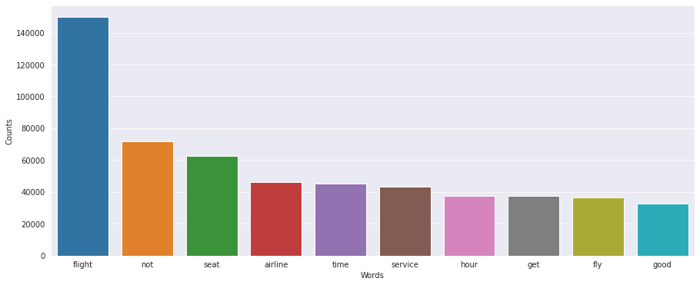
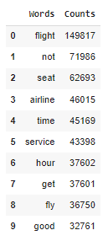
Identified Top 10 Words In Whole Customer Review Feature.
Observation:-
We Found that “Flight” Word has a count of 149817 in the whole customer review feature followed by “not”, ”Seat”, “airline”, etc.

Slide 16
Conversion of text data to numerical data for Model Understanding.
Count Vectorizer and TF-IDF is the mostly used method to convert text data into numerical data.
For our project we have selected TF-IDF.
TF-IDF(Term Frequency and inverse Document frequency):-
It is a numerical statistic that is intended to reflect how important a word is to a document in a collection or corpus It is often used as a weighting factor in searches of information retrieval, text mining, and user modeling.
The TF-IDF value increases proportionally to the number of times a word appears in the document and is offset by the number of documents in the corpus that contain the word, which helps to adjust for the fact that some words appear more frequently in general. TF-IDF is one of the most popular term-weighting schemes today. A survey conducted in 2015 showed that 83% of text-based recommender systems in digital libraries use TF-IDF.

Slide 17
Model Building:-
A machine learning model is a program that can find patterns or make decisions from a previously unseen data set. The process of running a machine learning algorithm on a dataset (called training data) and optimizing the algorithm to find certain patterns or outputs is called model training. The resulting function with rules and data structures is called the trained machine learning model.
We have used below some of the model for our project to achieve high accuracy result of Airline Passenger Referral Prediction
Logistic Regression.
Naïve Bayes.
Passive Aggressive Classifier.
Random Forest Classifier.
Gradient Boosting Classifier.

Slide 18
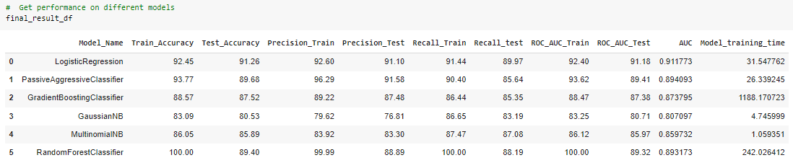
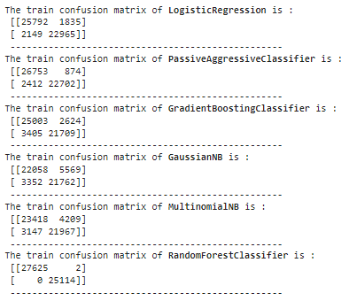
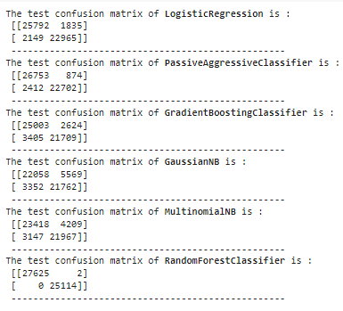
Comparing evaluation metrics of the models being used:-

Slide 19
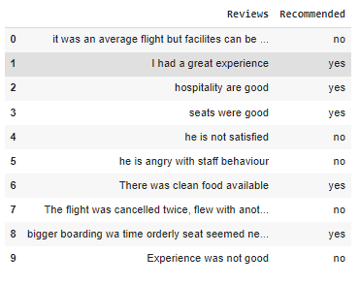
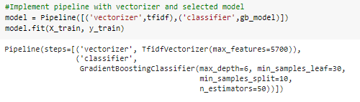
Model Performance Checked.
We Implemented trained model on some of the random examples (manually feeded) to check performance and accuracy of the model.
We used Sklearn Pipeline library to check model performance.
Observation:-
We found that model performed quite well on some example other than dataset provided.

Slide 20
Conclusion:-
The highest peak of the month feature is 7. According to legend, July is the month with the most travel. December is the second-most popular month.
Most trips are taken by Spirit Airlines, which has the highest frequency in the dataset.
The most trips taken were made by Airbus A320 aircraft, which had the highest frequency in the dataset, followed by Boeing 777 and Airbus A380 aircraft.
Top spot pertains to the Bangkok to Hong Kong trip that occurred most frequently in the dataset, followed by Bangkok to London and London to New York trips.
In the column for traveler type, it is noticeable to us that Solo Leisure travelers represent the majority of the population. In the cabin column, the majority of passengers prefer the Economy class.
Following the use of bivariate analysis, we discovered that all travelers highly favor the economy class. Some Couple Leisure and Business class travelers choose to fly in business class. Among all traveler types, first class is the least popular.
Based on customer satisfaction, Cathay Pacific Airways of Hong Kong is the most preferred airline. As indicated by stats, we were able to make several intriguing deductions, such as the Airbus A380 operated by Emirates Airlines being the most well-liked aircraft. However, based on ratings for all airlines, Emirates Airlines is not the most well-liked airline.
Conclusion to be Continue

Slide 21
American Airlines was at a downtrend in its early years, but in 2018 it reached its highest peak ever and became the most popular airline for its operations. From 2014 until 2017, United Airlines of the USA kept the top spot, but after that, the performance of its operations continued to decline. In its early years, Emirates Airlines was the least popular, but in 2018 it grew its client base and kept its position in the top 3 airlines. We have also analyzed above that spirit airlines is least preferred by travelers, However we can also see that in the above trend graph.
Due to the linear and balanced dataset, logistic regression outperformed the other algorithms well. Gradient boosting approach came in second.
For this sort of dataset and its specified problem statement, accuracy and f1 score are the optimal evaluation matrix that is taken into consideration.
Problems faced During Project.
Handling the null values and duplicates: It is evident from the analysis above that our dataset has a significant number of null values.
We can observe that a lot of rating variables have strongly correlated with the overall rating column.
The text in the customer review field was unformatted and included both alphanumeric and special characters.
We were unable to train the model with more data due to the computational complexity

Slide 22
THANK YOU

